Slide 1
“Be anxious for nothing, but in everything by prayer and supplication, with thanksgiving, let your requests be made known to God.”
(Philippians 4:6)
Notes:
Taken from a slide found on Facebook
Preached December 16, 2012 PM
Print Slides 2, 14, 15

Slide 4
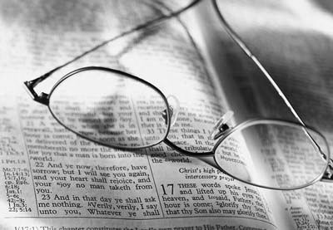
Hebrews 13:5-6
Let your conduct be without covetousness; be content with such things as you have. For He Himself has said, “I will never leave you nor forsake you.” ⁶ So we may boldly say: “The Lord is my helper; I will not fear. What can man do to me?”

Slide 6
1 Corinthians 12:23-25
And those members of the body which we think to be less honorable, on these we bestow greater honor; and our unpresentable parts have greater modesty, ²⁴ but our presentable parts have no need. But God composed the body, having given greater honor to that part which lacks it, ²⁵ that there should be no schism in the body, but that the members should have the same care for one another.

Slide 8
Jeremiah 29:10-14a
For thus says the Lord: After seventy years are completed at Babylon, I will visit you and perform My good word toward you, and cause you to return to this place. ¹¹ For I know the thoughts that I think toward you, says the Lord, thoughts of peace and not of evil, to give you a future and a hope. ¹² Then you will call upon Me and go and pray to Me, and I will listen to you. ¹³ And you will seek Me and find Me, when you search for Me with all your heart. ¹⁴ I will be found by you, says the Lord…

Slide 9
John 14:1-4
Let not your heart be troubled; you believe in God, believe also in Me. ² In My Father’s house are many mansions; if it were not so, I would have told you. I go to prepare a place for you. ³ And if I go and prepare a place for you, I will come again and receive you to Myself; that where I am, there you may be also. ⁴ And where I go you know, and the way you know.”

Slide 11
1 Peter 5:6-7
Therefore humble yourselves under the mighty hand of God, that He may exalt you in due time, ⁷ casting all your care upon Him, for He cares for you.
1 Thessalonians 5:17
Pray without ceasing.

Slide 13
1 John 1:9
If we confess our sins, He is faithful and just to forgive us our sins and to cleanse us from all unrighteousness.

Slide 14
Conclusion
There are many things that cause anxiety for people in our time.
Health problems, economic worries, social unrest, racial intolerance, international violence.
But, the Christian knows that God knows, and our confidence comes from the relationship we enjoy as His children.

Slide 15
Philippians 4:6-7
Be anxious for nothing, but in everything by prayer and supplication, with thanksgiving, let your requests be made known to God; ⁷ and the peace of God, which surpasses all understanding, will guard your hearts and minds through Christ Jesus.

